Slide 1
Chapt 2-1: Memory hierarchy
Memory hierarchy
The basic of cache
Organization of main memory
1

Slide 2
Chapter B & 2: Memory Hierarchy
Memory Hierarchy ABC
How to improve Cache performance
Memory Organization
Virtual Memory

Slide 3
2.1 Introduction
Why do designers need to know about memory technology?
Processor performance is usually limited by memory bandwidth
As IC densities increase, lots of memory will fit on processor chip
Application requirements:
Unlimited amounts of memory
Faster memory, higher bandwidth
Lower price per byte
If for embedded systems: lower power comsumption
These requirements are contradictory.
The bigger, more difficult to make it fast
The faster, more expensive
The faster will consume much more power.

Slide 4
Memory Technologies
Random Access Memories
DRAM: Dynamic Random Access Memory
High density, low power, cheap, slow
Dynamic: needs to be “refreshed” regularly
SRAM: Static Random Access Memory
Low density, high power, expensive, fast
Static: content will last “forever”(until lose power)
What gets used where?
Main memory is DRAM: you need it big, so you need it cheap
CPU cache memory is SRAM: you need it fast, so it’s more expensive, so it’s smaller than you would usually want due to resource limitations
Relative performance
Size: DRAM/SRAM: 4-8x bigger for DRAM
Cost/Cycle time: SRAM/DRAM: 8-16x faster, more $$$ for SRAM

Slide 5
Memory Hierarchy: a natural Solution
How can we provide a memory with small access time, big capacity and lower price ?
The first principle: make the common case fast !
What is the common case ?
Recall: the principle of locality of reference !
Program access a relatively small portion of the address space at any instant of time.
Ok, we should make these accesses more quickly.
We can hold the recently accessed items in a fast memory.
Yeah: Smaller memories will be faster !
We can use more expensive and smaller memories to hold the most recently used items.
The cost and power impact is lessoned for small size.

Slide 6
What is Memory Hierarchy ?
Memory hierarchy is organized into several levels:
Each smaller, faster, and more expensive per byte than the next lower level.
Temporal Locality (Locality in Time):
⇒ Keep most recently accessed data items closer to the processor
Spatial Locality (Locality in Space):
⇒ Move blocks consists of contiguous words to the faster levels
Notes:
Y-axis is performance
X-axis is time
Latency
Cliché:
Not e that x86 didn’t have cache on chip until 1989

Slide 7
Memory Hierarchy
The goal:To provide a memory system with cost most almost as low as the cheapest level of memory and speed almost as fast as the fastest level.
Processor
Control
Secondary
Storage
(Disk)
Second
Level
Cache
(SRAM)
Main
Memory
(DRAM)
Datapath
On-Chip
Cache
Registers
Compiler
Hardware
Speed:
Fastest
Operating System
Slowest
Size:
Smallest
Biggest
Cost:
Highest
Lowest

Slide 8
Levels of the Memory Hierarchy
Capacity
Access Time
Cost
Upper Level
Staging
Xfer Unit
faster
CPU Registers
500 Bytes
<250 ps
Registers
Instr. Operands
prog./compiler
1-8 bytes
Cache
K Bytes
1-10ns
1-0.1 cents/bit
Cache
Blocks
cache cntl
8-128 bytes
Main Memory
1G Bytes
100ns- 150ns
$.0001-.00001 cents /bit
Memory
Pages
OS
512-4K bytes
Disk
T Bytes, 10 ms (10⁻⁵-10⁻⁶ cents/bit
Disk
Files
user/operator
Mbytes
Tape
infinite
sec-min
10⁻⁸
Larger
Tape
Lower Level

Slide 9
Who Cares About the Memory Hierarchy?
µProc
52%/yr.
µProc
20%/yr.
CPU
“Moore’s Law”
Processor-Memory
Performance Gap: (grows 50% / year)
µProc
25%/yr.
“Less’ Law?”
DRAM
7%/yr.
DRAM
1980: no cache in µproc; 2001: 2-level cache on chip (1989 first Intel µproc with a cache on chip)

Slide 10
Different concerns for desktops, servers, and embedded computers
Desktop computers:
primarily running one application for single user
concerned more with average latency from the memory hierarchy.
Servers computers:
May have hundreds of users running potentially
dozens of applications simultaneously.
concerned about memory bandwidth.
Embedded computers:
Used for real-time applications, so worst-case performance is a focus
Power and battery life, may NOT choose hardware optimizations
Running only one application using very simple OS, so protection role of memory is often diminished.
Notes:
1st generation
Latency 1/2
but Clock rate 3X and IPC is 3X
Now move to other 1/2 of industry

Slide 11
Memory Hierarchy Terminology
Hit: data appears in some block in the faster level (Block X)
Hit Rate the fraction of memory access found in the faster level
Hit Time: Time to access the faster level which consists of
Memory access time + Time to determine hit/miss
Miss: data needs to be retrieve from a block in the slower level (Block Y)
Miss Rate = 1 - (Hit Rate)
Miss Penalty: Time to replace a block in the upper level +
Time to deliver the block to the processor
Hit Time << Miss Penalty
Slower Level
Memory
To Processor
Faster Level
Memory
Block X
From Processor
Block Y

Slide 12
Review of the ABCs of Caches
36 terms of Cache
Cache Virtual memory
data cache Instruction cache unified cache
block page tag field
Block address index field block offset
full associative set associative direct mapped
n-way set associative set address trace
misses per instruction Memory stall cycles miss penalty
Valid bit dirty bit locality
cache hit hit time
cache miss miss rate page fault
Write through write back write allocate
random replacememt least-recently used no-write allocate
Average memory access time write buffer write stall

Slide 13
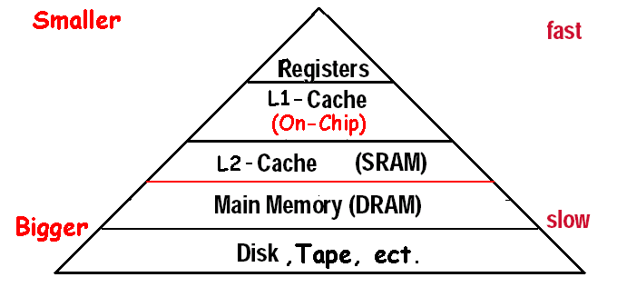
What is a cache?
Small, fast storage used to improve average access time to slow memory.
In computer architecture, almost everything is a cache!
Registers “a cache” on variables – software managed
First-level cache a cache on second-level cache
Second-level cache a cache on memory
Memory a cache on disk (virtual memory)
TLB a cache on page table
Branch-prediction a cache on prediction information?

Slide 14
Four Questions for Memory Hierarchy Designers
Q1: Where can a block be placed in the upper level?
(Block placement)
Fully Associative, Set Associative, Direct Mapped
Q2: How is a block found if it is in the upper level? (Block identification)
Tag/Block
Q3: Which block should be replaced on a miss? (Block replacement)
Random, LRU,FIFO
Q4: What happens on a write? (Write strategy)
Write Back or Write Through (with Write Buffer)

Slide 15
Q1: Block Placement
Direct mapped
Block can only go in one place in the cache
Usually (address) MOD (Number of blocks in cache)
Fully associative
Block can go anywhere in cache.
Set associative
Block can go in one of a set of places in the cache.
A set is a group of blocks in the cache.
(Block address) MOD (Number of sets in the cache)
If sets have n blocks, the cache is said to be n-way set associative.
Note that direct mapped is the same as 1-way set associative, and fully associative is m-way set-associative (for a cache with m blocks).

Slide 16
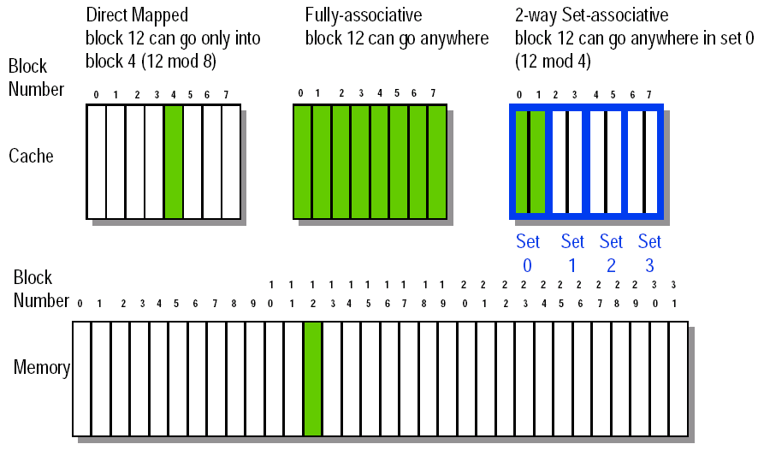
8-32 Block Placement

Slide 17
Q2: Block Identification
Every block has an address tag that stores the main memory address of the data stored in the block.
When checking the cache, the processor will compare the requested memory address to the cache tag -- if the two are equal, then there is a cache hit and the data is present in the cache
Often, each cache block also has a valid bit that tells if the contents of the cache block are valid

Slide 18
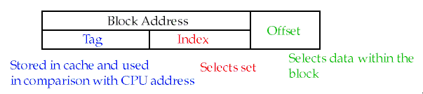
The Format of the Physical Address
The Index field selects
The set, in case of a set-associative cache
The block, in case of a direct-mapped cache
The Byte Offset field selects
The byte within the block
Has as many bits as log₂(size of block)
The Tag is used to find the matching block within a set or in the cache
Has as many bits as
(AddressSize) – (IndexSize) – (ByteOffsetSize)

Slide 19
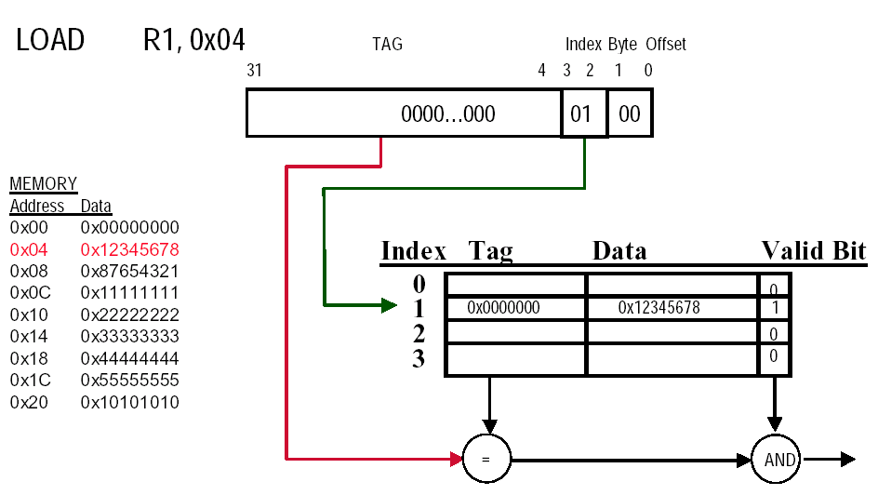
Direct-mapped Cache Example (1-word Blocks)

Slide 20
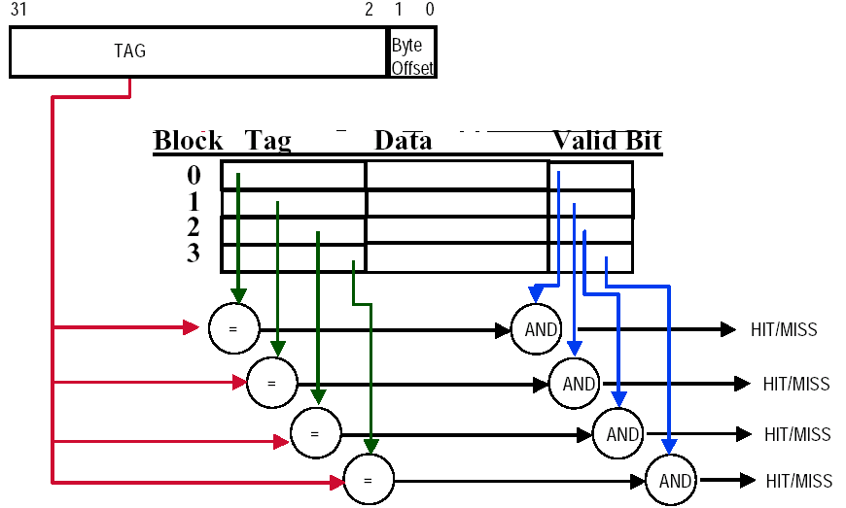
Fully-Associative Cache example (1-word Blocks)
Assume cache has 4 blocks

Slide 21
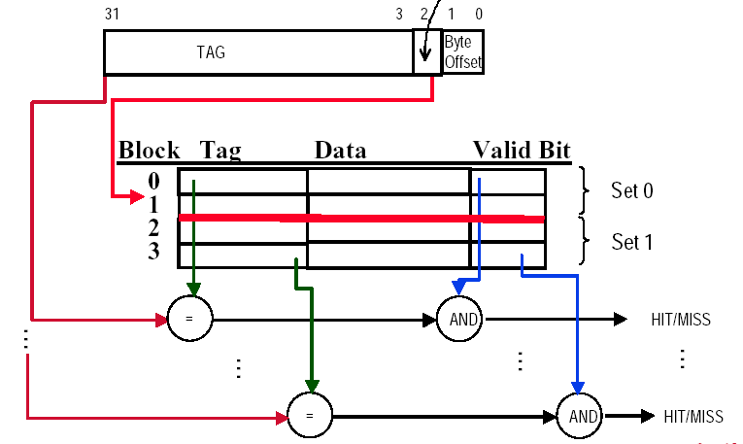
2-Way Set-Associative Cache
Assume cache has 4 blocks and each block is 1 word
2 blocks per set, hence 2 sets per cache
index

Slide 22
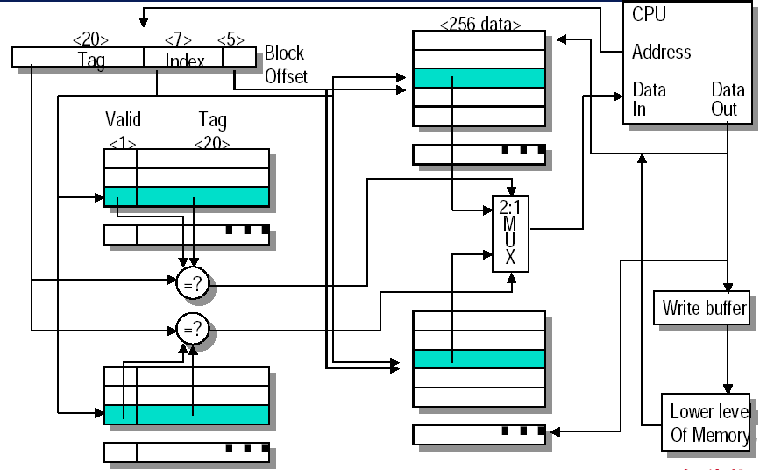
Example: set associate cache
Memory size: 4G, Cache 8K, 2-way set associate

Slide 23
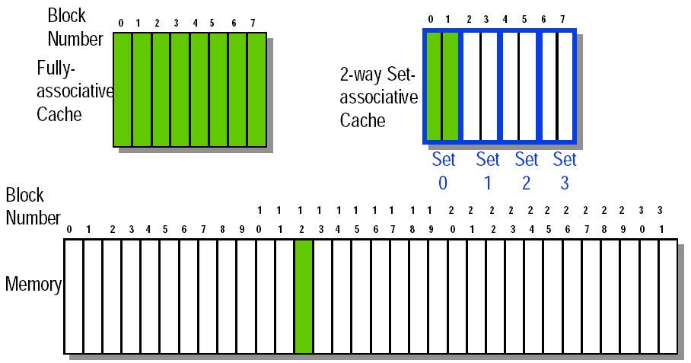
Q3: Block Replacement
In a direct-mapped cache, there is only one block that can be replaced
In set-associative and fully-associative caches, there are N blocks (where N is the degree of associativity

Slide 24
Strategy of block Replacement
Random replacement - randomly pick any block
Easy to implement in hardware, just requires a random number generator
Spreads allocation uniformly across cache
May evict a block that is about to be accessed
Least-recently used (LRU) - pick the block in the set which was least recently accessed
Assumed more recently accessed blocks more likely to be referenced again
This requires extra bits in the cache to keep track of accesses.
First in,first out(FIFO)-Choose a block from the set which was first came into the cache

Slide 25
Implementation of Replacement
Psedo LRU
Example:
V NV
A 1 0
B 0 1
C 0 0
D 0 0
When Miss:
Kick out the Victim,
Make the NextVictim to be Victim,
and select one from the left two blocks to be the NextVictim

Slide 26
Another psedo LRU
3 bit for a set ( 4-way )
One bit for which is the LRU in AB
One bit for which is the LRU in CD
One bit for which is the LRU in AB / CD

Slide 27
Q4: Write Strategy
When data is written into the cache (on a store), is the data also written to main memory?
write-through : The information is written to both the block in the cache and to the block in the slower memory
Cache control bit: only a valid bit
memory (or other processors) always have latest data
Always combined with write buffers so that don’t wait for slow memory
write-back:The information is written only to the block in the cache. The modified cache block is written to main memory only when it is replaced
Cache control bits: both valid and dirty bits
much lower bandwidth, since No writes to slow memory for repeated write accesses

Slide 28
Pros and Cons for write strategy
Write-through adv:
Read misses don't result in writes,
memory hierarchy is consistent and it is simple to implement.
Write back adv:
Writes occur at speed of cache
main memory bandwidth is smaller when multiple writes occur to the same block.
Notes:
可能是write back和write through比需要的内存带宽降低 ，因为基本都写cache里了
(上面两个方法的对比）

Slide 29
Write stall
Write stall ---When the CPU must wait for writes to complete during write through
Write buffers
A small cache that can hold a few values waiting to go to main memory,to avoid stalling on writes
This buffer helps when writes are clustered.
It does not entirely eliminate stalls since it is possible for the buffer to fill if the burst is larger than the buffer.

Slide 30
Write Through via Buffering
Cache
Processor
DRAM
Write Buffer
Processor writes data into the cache and the write buffer
Memory controller writes contents of the buffer to memory
Increased write frequency can cause saturation of write buffer
If CPU cycle time too fast and/or too many store instr. in a row:
Store buffer will overflow no matter how big you make it
The CPU Cycle Time get closer to DRAM Write Cycle Time
Write buffer saturation can be handled by installing a second level (L2) cache
Cache
L2
Cache
Processor
DRAM
Write Buffer

Slide 31
Write buffers
CPU
in out
Write Buffer
write
buffer
DRAM
(or lower mem)

Slide 32
Write policy when misses
If a miss occurs on a write (the block is not present), there are two options.
Write allocate
The block is loaded into the cache on a miss before anything else occurs.
Write around (no write allocate)
The block is only written to main memory
It is not stored in the cache.
In general, write-back caches use write-allocate , and write-through caches use write-around .

Slide 33
Example
Assume a fully associative wtrie-back cache with many cache entries that starts empty.below is a sequence of five memory operations(the address is in square brackets):
1 write Mem[100];
2 write Mem[100];
3 Read Mem[200];
4 write Mem[200];
5 write Mem[100];
What are the number of hits and misses when using no-write allocate versus write allocate?
Answer :
for no-write allocate misses: 1,2,3,5
hit : 4
for write allocate misses: 1,3
hit : 2,4,5

Slide 34
Split vs. unified caches
Unified cache
All memory requests go through a single cache.
This requires less hardware, but also has lower hit rate
Split I & D cache
A separate cache is used for instructions and data.
This uses additional hardware, though there are some simplifications (the I cache is read-only).
Proc
Unified
Cache-1
I-Cache-1
Proc
D-Cache-1
Unified
Cache-2
Unified
Cache-2

Slide 35
Split vs. mixed cache
Miss per 1000 instructions for 2-way associate cache.
Average miss rate = Inst% × MRinst. + Data% ×MRdata
Split : remove the misses due to conflicts between inst. blocks and data blocks , but has fixed cache space for both instructions and data.

Slide 36
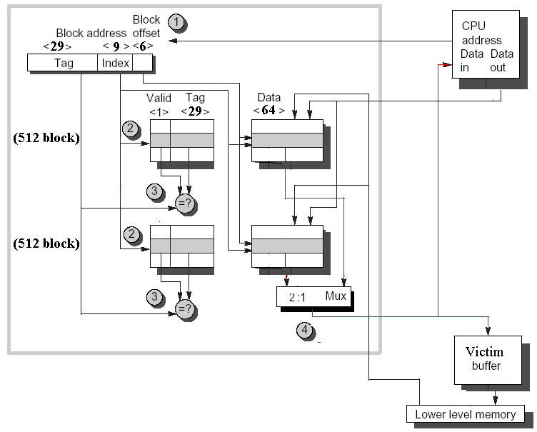
Example:Alpha 21264 data cache

Slide 37
Superviser cache / User cache
Instruction Cache
Supervisor/ User Space Bit
1: Supervisor access only
0: Supervisor / User access

Slide 38
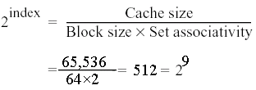
Procedure for Cache Accessing
Step1 Cache is divided into 2 fields: the 38 bit block address and the 6-bit block offset(64=2⁶and 38+6=44).
Step2 Index selection , Reading the two tags from cache.
Step3 the two tags are compared and the winner is selected.Tag contains the valid bit, otherwise the results of the comparion are ignored.
Step4 If one tag does match, CPU loads the proper data from the cache, otherwise from main memory.
The 21264 allows 3 clock cycles for these four steps,so the instructions in the following 2 clock cycles would wait if they tried to use the result of the load.

